Slide 1




Modern web development
Taught by: Papko Vladislav
Protei Ltd., team lead

Slide 2
Course Roadmap
Introduction
Angular basics
Advanced angular

Slide 3
Introduction
Introduction to JS
Tools overview

Slide 4
Angular basics
Project sturcture
Components
Services, Dependency Injection
Forms
Routing
Directives, Pipes
Webpack

Slide 5
Advanced angular
AOT and JIT compilation
Dynamic rendering of components
Reactive programing, RxJs
Flux, Ngrx/store
Unit testing
Zones, Change detection

Slide 6

What is JavaScript?
JavaScript is a high-level, dynamic, weakly typed, object-based, multi-paradigm, and interpreted programming language.
Alongside HTML and CSS, JavaScript is one of the three core technologies of World Wide Web content production.

Slide 7
ECMAScript (ES)
ES is is a trademarked scripting-language specification.
ES5
ES6 (ES2015)
ES 2016-2017

Slide 8
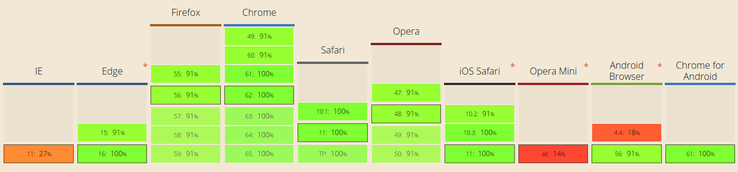
Browsers and their JS engines
V8 – Chrome
Rhino – Mozilla Foundation
Chakra – Microsoft edge

Slide 9
Basics (demo 1)
<script> tag
Variables and types
Loops, conditional expressions
Functions. Function declaration, function expression (named or not). Arrow functions
Closures, scope

Slide 10
Functions (demo1_2)
 | Function Declaration | Function Expression
Creation time | Before the first code line execution | When reaches code line with this function
Can you call it before it was declared | Yes | No
Conditional declaration | Works | Doesn’t work

Slide 11
Closures, scope (demo 2)
Global variables (global object window in browser)
Lexical environment
Closure is a function with all available to it outer variables.

Slide 12
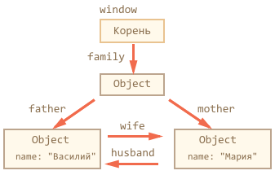
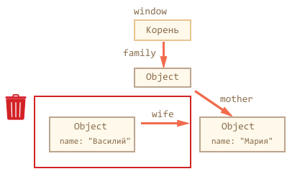
Garbage collector (demo 3)

Slide 13
Object methods, this (demo 4)
This – call context, it is defined at a function call moment.
You can call one function in different contextes.
If you call this without context it will be global object value.
If you call function not like obj.fun() or obj[‘fun’]() it will lose its context.
You can use call, apply or bind methods to provide a context to function.

Slide 14
OOP in JS (demo 5)
Functional style
Prototype style

Slide 15
Object prototype (demo 5_2)
__proto__ field in object
hasOwnProperty
Object.create() creates object without prototype

Slide 16
ES2015
let and const
destructuring
arrow functions
strings
classes
promise
generators, iterators, modules...

Slide 17
Q&A

